Slide 1
Quick Ingest & Exploratory Data Analysis
The Foundation for Machine Learning on ATTEST Logs

Slide 2
Objective:
Prepare and integrate datasets from Task 1 and Task 2 by combining cleaned log messages, cluster labels, and test metadata for model training.
Create reliable training labels using log status (Passed/Failed/Aborted) or failure cluster tags (Timeout, Interface Error, etc.) to support accurate classification.
Develop machine learning classification models using TF-IDF or embedding-based features to predict log types or failure categories for unseen log messages.
Implement anomaly detection techniques (Isolation Forest) to identify abnormal or unexpected log patterns that deviate from known behaviors.
Visualize model performance and anomalies through confusion matrices, anomaly score distributions, and PCA/t-SNE plots to understand patterns and detect outliers.
Generate automated outputs and insights such as classified logs, anomaly reports, and visual summaries to support debugging, analysis, and continuous improvement.

Slide 3
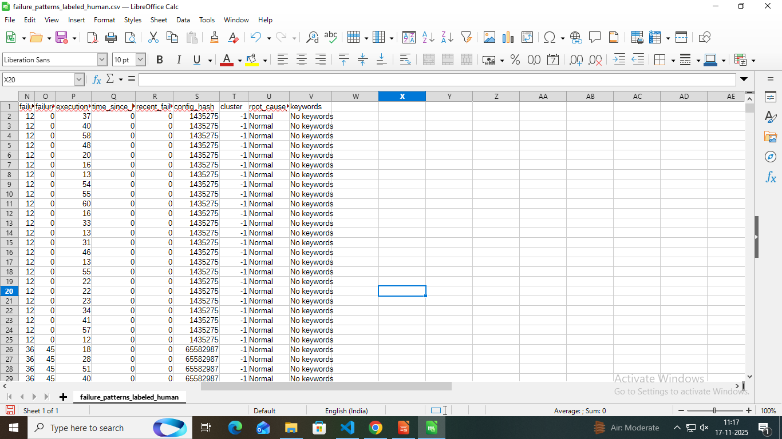
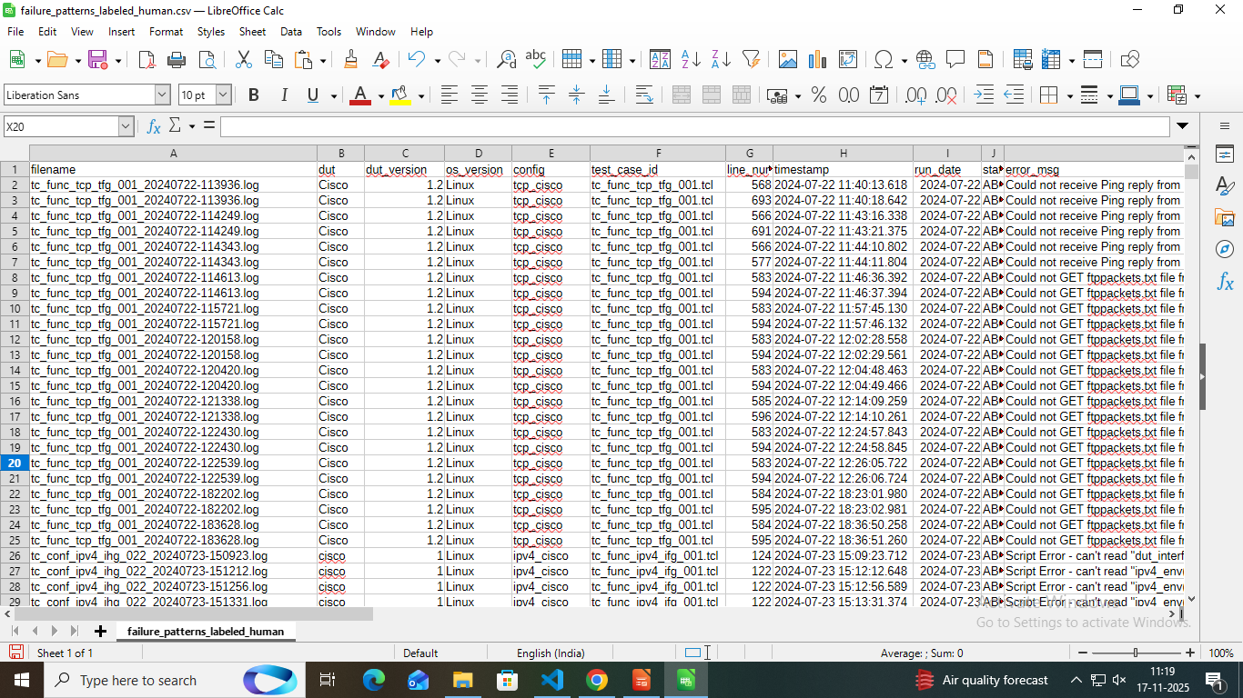
Data Preparation:
Imported cleaned log data and clustering output using Pandas.
Merged datasets from Task 1 and Task 2 using the message field as the common identifier.
Extracted important metadata including Testcase, DUT, Suite, and ClusterID for deeper analysis.
Created classification labels based on:
->Execution status (Passed / Failed / Aborted)
->Failure cluster tags (e.g., Timeout, Interface Error, Device Reset)

Slide 4
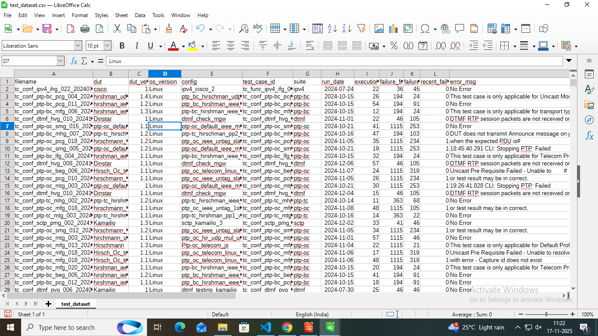
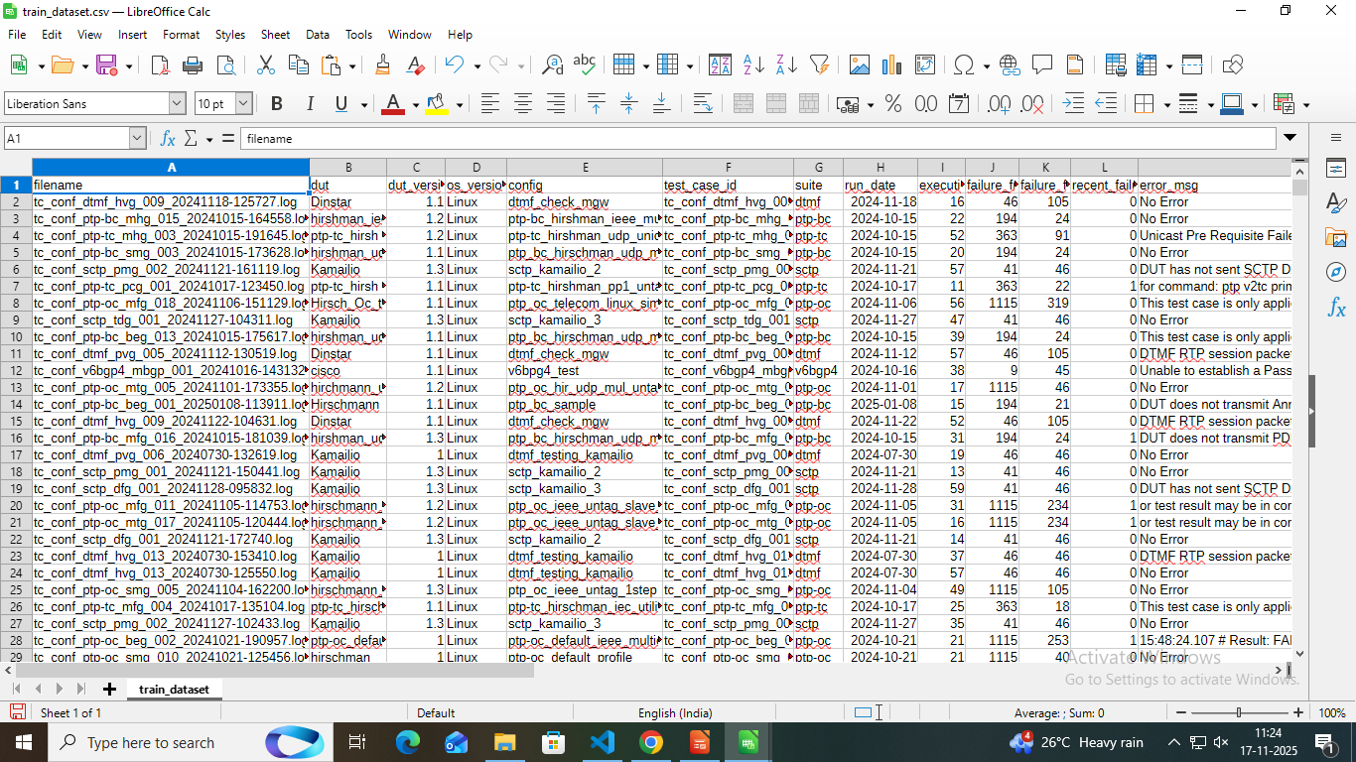
Splitting & Preprocessing:
Cleaned the raw messages by removing timestamps, symbols, and unnecessary whitespace.
Converted text to lowercase and applied tokenization for consistent processing.
Used TF-IDF vectorization to transform log messages into numerical feature vectors suitable for ML models.
Enriched the dataset with additional numeric features, such as:
=>Execution duration
=>Error occurrence frequency
=>Cluster ID from Task 2 (for better pattern separation)
Split the processed dataset into 80% training and 20% testing using train_test_split to ensure reliable model evaluation.

Slide 5
Log Classification:
First, we transformed all log messages into numerical features using TF-IDF, because machine-learning models cannot understand raw text.
Using these TF-IDF features, we trained a Random Forest model to learn patterns in the logs and classify them correctly.
After training, we evaluated the model on the test dataset to measure accuracy and ensure the model works well on unseen data.
Then, the model generated predictions and confidence scores for each log message, showing how sure the model is about each classification.
Finally, we saved the trained Random Forest model using joblib.dump(), so it can be reused later without training again.

Slide 6
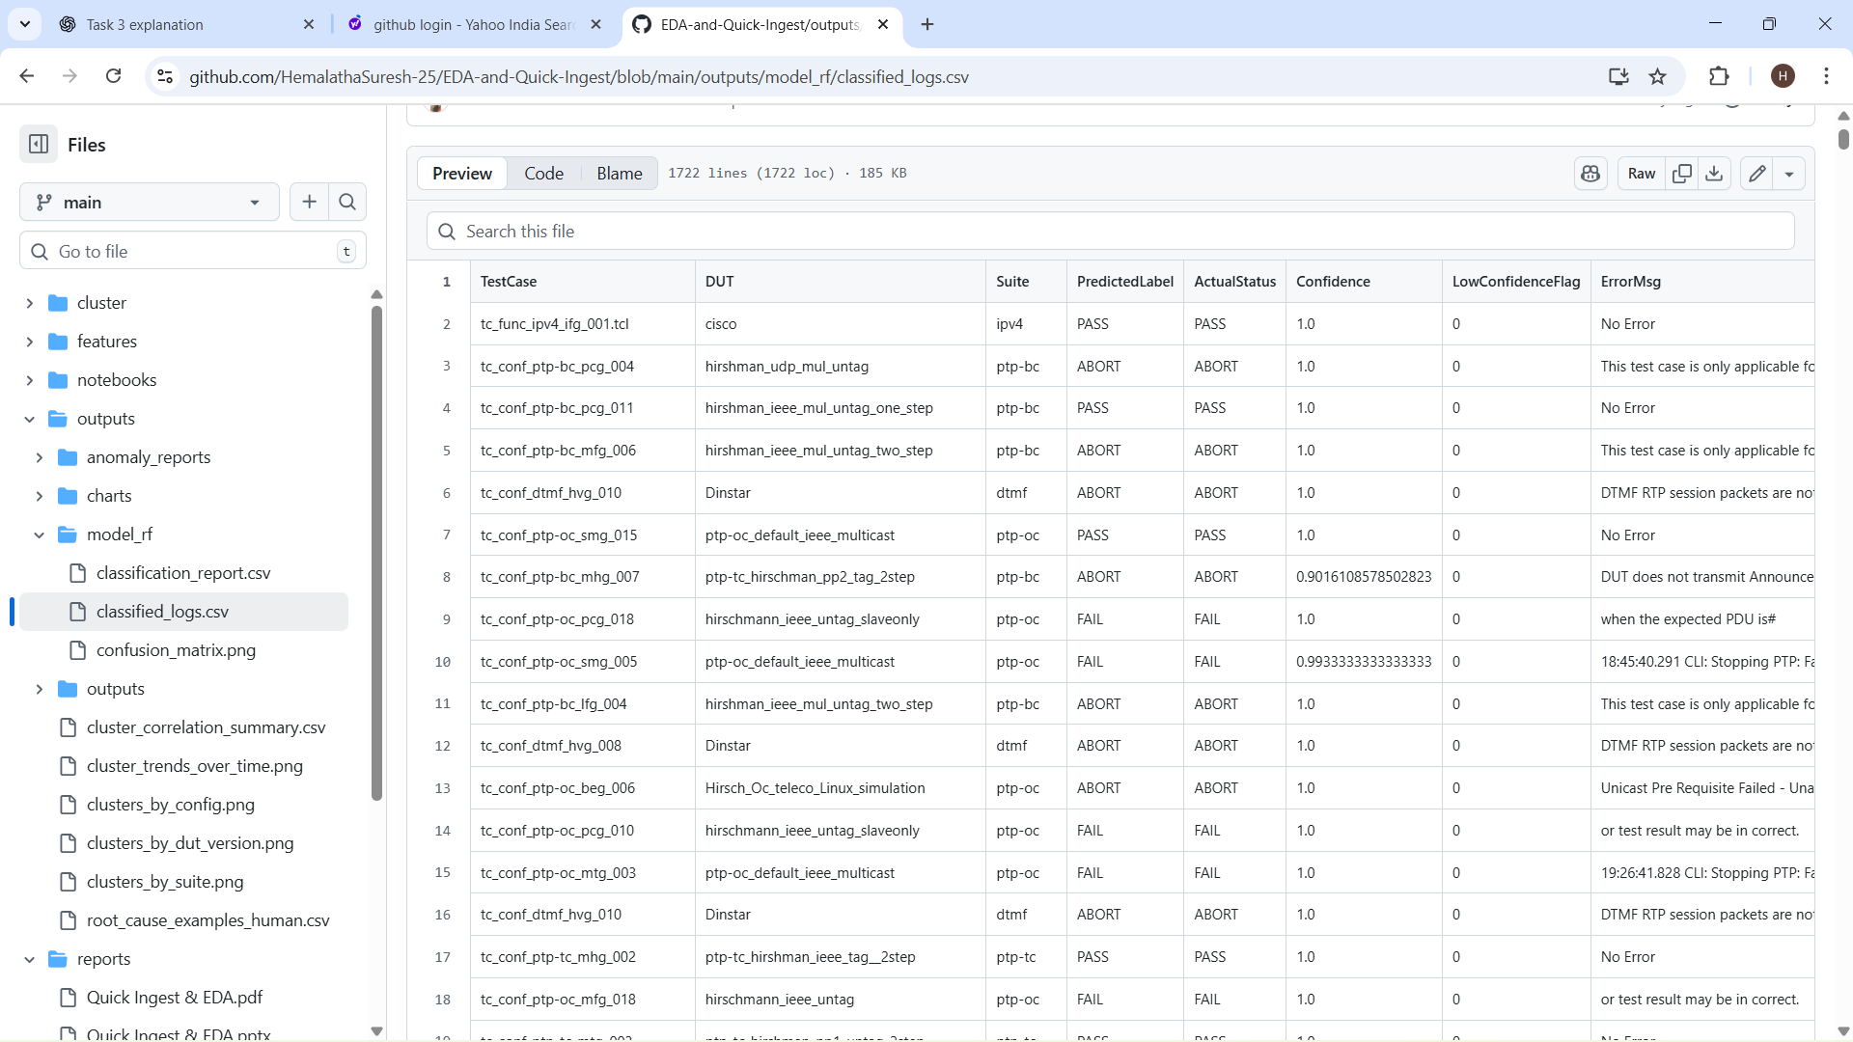
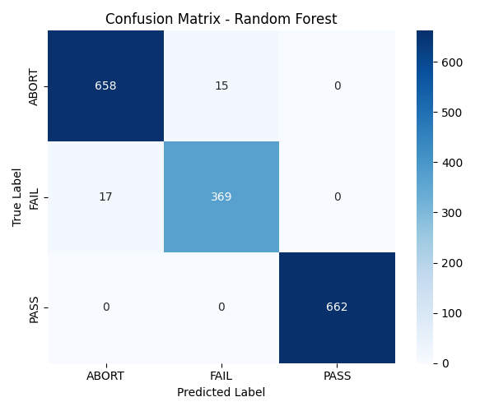
Classification Output:
TestCase — the specific test that produced the log
DUT — device under test
Suite — test suite category
PredictedLabel — model’s prediction (PASS / FAIL / ABORT)
ActualStatus — ground truth
Confidence Score — how sure the model is (0.0–1.0)
LowConfidenceFlag — highlights predictions below a threshold
ErrorMsg — short error snippet from the log
Compared PredictedLabel vs ActualStatus
Identified confusing or borderline logs
Tuned Random Forest hyperparameters to improve accuracy
Checked low-confidence predictions to refine thresholds

Slide 7
Anomaly Detection:
We transformed the raw text into numeric features using TF-IDF / Word2Vec / BERT so the model can recognize patterns and compare logs mathematically.
The model was trained on logs that represent regular system behavior, allowing it to understand what “normal” execution looks like.
From the training data, Isolation Forest identified the common structure, wording, and frequency of normal log messages.
After training, every new log was assigned a score indicating how different it is from the patterns the model learned.
If a log message looked unusual or rare (based on its score), it was flagged as a potential issue for further inspection.

Slide 8
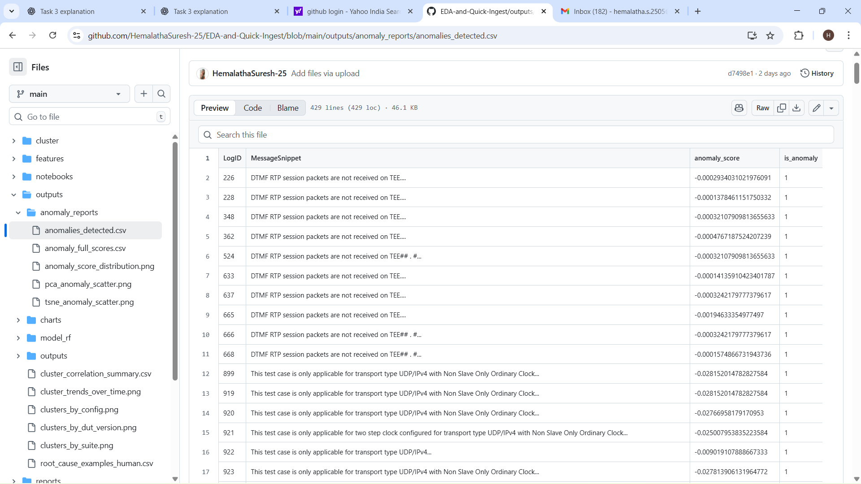
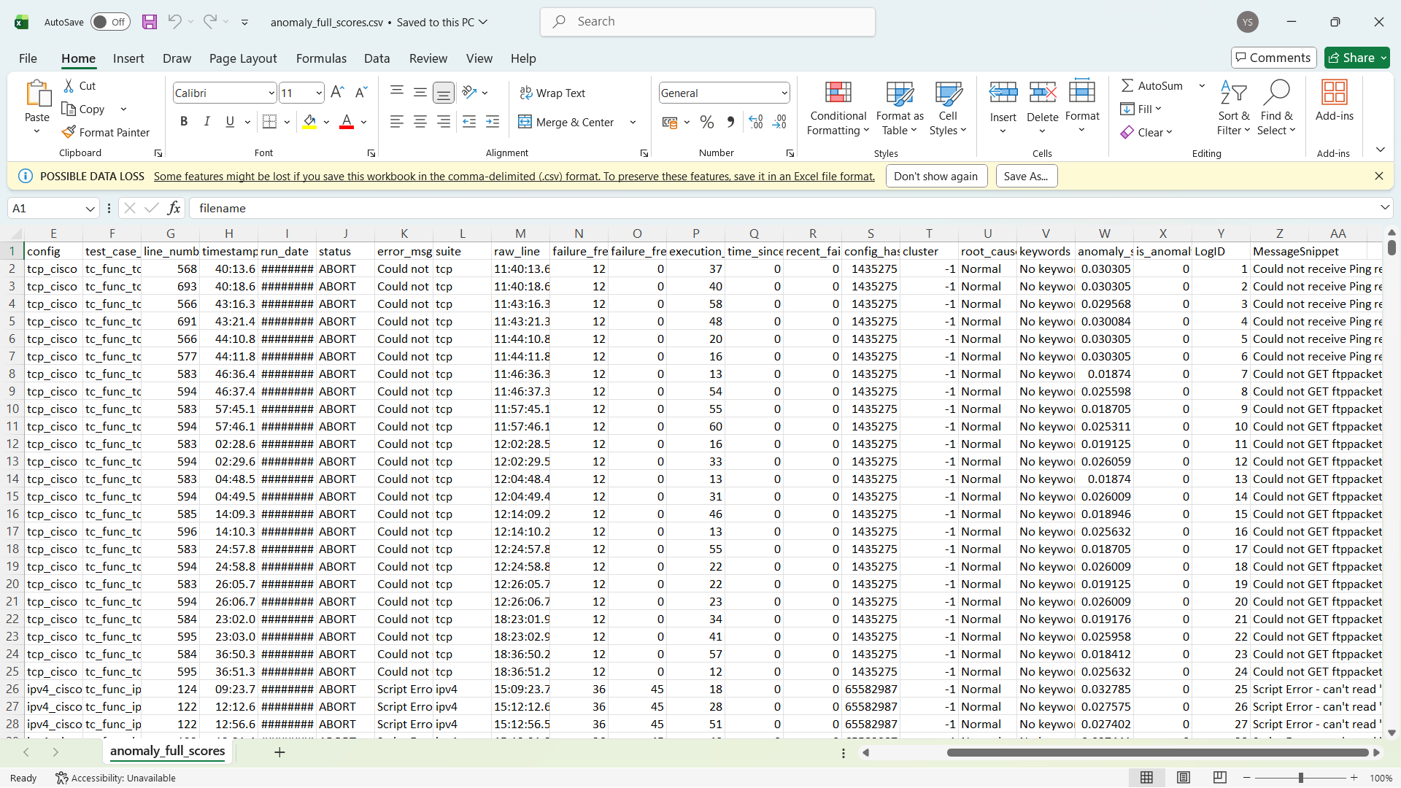
Anomaly Output:
anomalies_detected.csv (Final Anomalies Only)
This file contains only the logs that were flagged as anomalies.
It includes:
LogID
Message Snippet
Anomaly Score (above threshold)
Is_anomaly
=> This is the main output file used for analysis.
=> It lists only the suspicious or abnormal logs.
anomaly_full_scores.csv (Scores for ALL logs)
This file contains anomaly scores for every log entry, not just the anomalous ones.
It includes:
LogID
Full Message (or snippet)
Anomaly Score, IsAnomaly Flag (0 = normal, 1 = anomaly)
ClusterID, Metadata
=>Understanding the distribution of scores
=>Choosing a better threshold
=>Visualizing the complete behaviour of the dataset

Slide 9
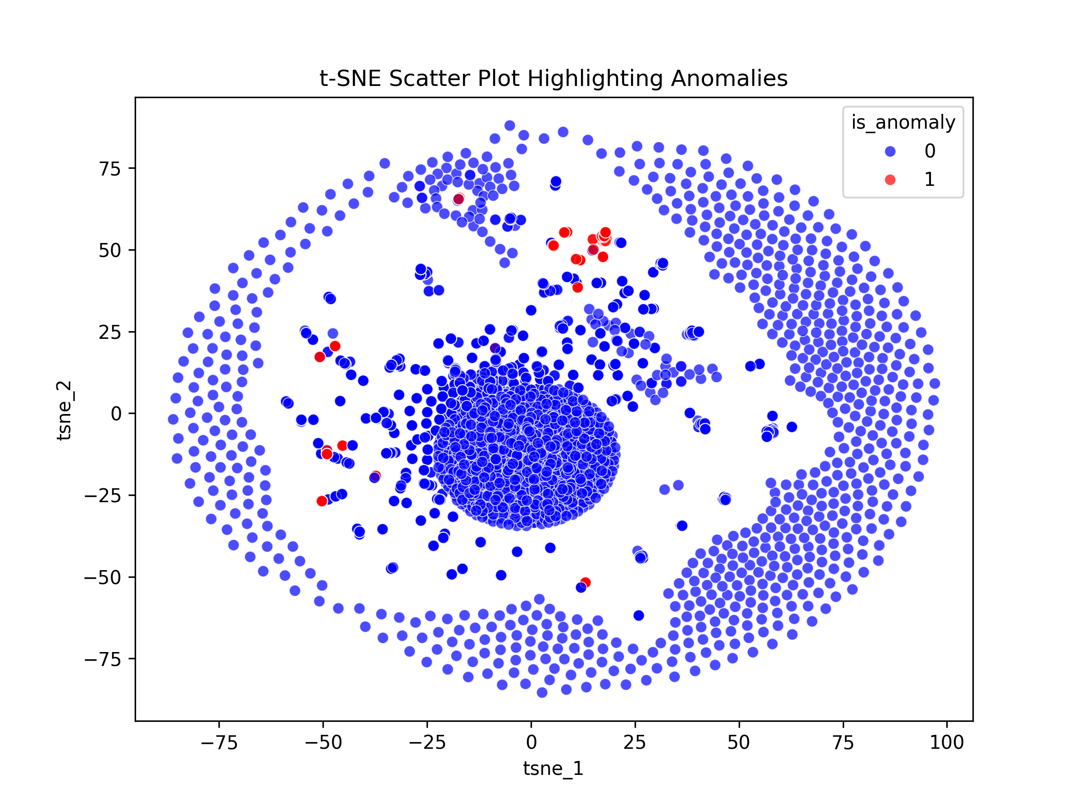
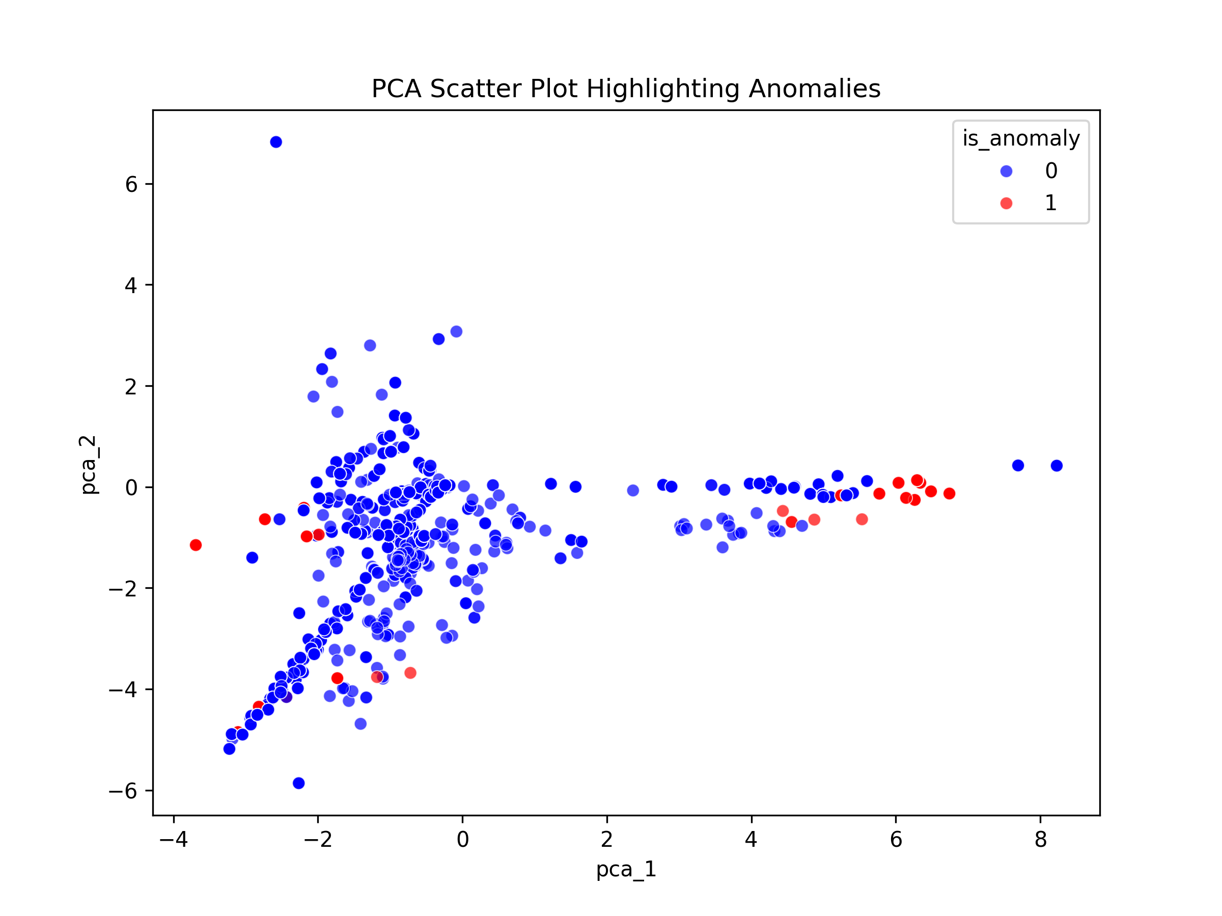
Visualization:
• Created visual graphs using Matplotlib and Seaborn
Used Python plotting libraries to convert model results into clear, understandable charts.
• Confusion Matrix for classification evaluation
Displayed how well the model predicted each class and helped identify misclassifications.
• Anomaly Score Histogram to analyze score distribution
Showed the range of anomaly scores and made it easy to see which logs were normal vs. abnormal.
• PCA / t-SNE scatter plot for dimensionality reduction
Reduced high-dimensional embeddings into 2D to visually separate normal patterns from anomalies.
• Cluster vs. Anomaly comparison plot
Plotted cluster labels from Task 2 and highlighted anomaly points to check if anomalies fall inside or outside known clusters.

Slide 10
Thank You

